Slide 1



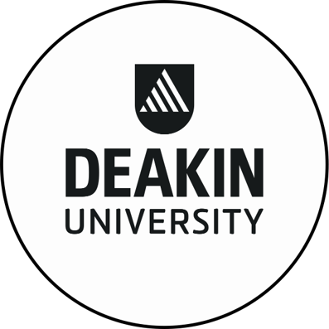
www.intelia.ai
Case Study – Once in a Decade Data Migration Program
Problem
Solution
Data Migration
Data Strategy
Unified Data Model
Data Vault Methodology
Data Quality and Tech Reconciliation
Deakin University continues to increase in terms of size, complexity and needs, current systems and processes will impact the support and success of researchers and their innovation. There is a risk that researchers could fall behind competitors who have already uplifted systems and processes to drive efficiencies and transform research administration and support to inform strategic decision-making. There are also potential risks posed by legacy, unsupported systems and gaps that may impact meeting both regulatory, strategic reporting and analytics requirements. As Deakin looked to tackle this challenge through a program of work they sought the expert assistance of a data consultancy as they did not have the data skills internally.
The solution included the following;
Data Migration Strategy: outlining how the proposed technology solution, in this case, SSIS would be used to migrate data.
Data Migration Governance Model - this highlighted how data being migrated would be reviewed, how data Data Quality issues could be resolved and escalated.
Unified Data Model - intelia defined a Unified Data Model to ensure that all data from multiple sources were correctly modelled to then be consumed and ingested into a data migration engine
Data Vault Methodology intelia utilised the Data Vault methodology to migrate data from source system to target.
Technical Reconciliation - Within a metadata view and using SSIS we adopted a repeatable technical reconciliation process that ensured DQ standards were met before presenting findings to the business
intelia’s Approach
Deakin University
Deakin University is a leading public university enabling globally connected education for the jobs of the future and research that makes a difference to our communities.
intelia was engaged as a key data partner for the University to commence on a program of work to ultimately assist the ineffective information management preventing the University from making more informed and timely decisions. By engaging intelia as their key data partner, the Program wanted to realise benefits that would:
Improve staff and higher degrees by research (HDR) student productivity and capacity to undertake research and innovation.
Be more effective research operations and services.
Have better data driven decisions to optimise strategic investment.
Outcome
Having an agreed and endorsed Data Migration Strategy, assisted Deakin to understand how technically data will be migrated as well as set expectations on effort, time and skill needed. Utilising the Unified Data Model and migrating data through the Data Vault methodology, data was in a consumable format to easily allow for technical transformations, Data Quality reconciliations, business approvals in an iterative approach allowed us the ability to and migrate data.
As a result of executing on our strategy, data was successfully migrated into production without any defects.
“The intelia team are highly professional and are experts in data and getting the job done. We don’t see them as another vendor but rather one of us "
- Deakin University Program Manager
With offices in Melbourne and Sydney, intelia is a technology consultancy specializing in all things data (strategy, architecture, governance, analytics, modern cloud data platforms and intelligent automation)

